Slide 1
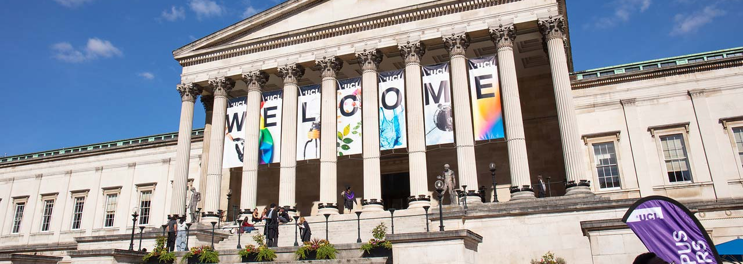
MyAccessID – Research Group Tenancies

Slide 2
MyAccessID Research Group Tenancies – Proof of Concept!
James Legg
Senior Infrastructure Developer
UCL Centre for Advanced Research Computing
(other responsibility: Project Contender, machines with novel architectures)
j.legg@ucl.ac.uk

Slide 3










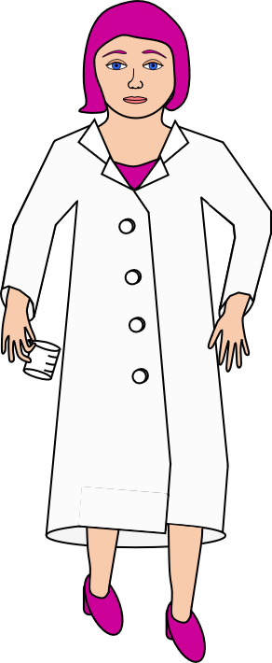
A digital home for your research group
ARC User Authentication
Your local team
- at home in their tenancy
Another University IdP
ARC CLOUD TENANCIES
Prof. Oversight (external user)
Group HQ
MyAccessID
Tenancy with compute and storage
University of Elsewhere IdP
PRIVATE CLOUD
Dr. Vital Collaborator
(external user)
Login request and access
Verification path for Dr. Vital Collaborator
Verification path difference for Prof. Oversight
= Identity Provider
MyAccessID is a broker facilitating access to diverse identity providers
IdP

Slide 4
Our journey - so yours may be shorter! Motivations:
Current theme of research funding is collaboration
And an actuality – how can external users use the services.
More demand for external access
ARC has range of external access solutions
Work around of Visitor accounts
Future needs
Various and bespoke
Dependent on hard pressed now separate department
Developing sensitivity to Visitor status in UK universities
Does not scale
Repeatable solution for new services, large and small
One ARC understands and can implement

Slide 5
Opportunity:
MyAccessID connection was easy
logged in with my home uni email address (…@ucl.ac.uk)
apparently no need for old school separate local account
Went to a workshop on IsambardAI at Bristol
Went to more Bristol workshops
Jisc appointed at UK agent for MyAccessID
ARC at UCL is developing private cloud
UCL Identity provider already connected
Met Bristol team
Met Jisc
Saw Waldur group and resource admin software (not in scope)
MyAccessID will go in private cloud
Private cloud owners probably can create users’ ids and permissions, not using main home uni staff / student accounts
True because I could use Isambard AI
This other half not impossible then
Isambard AI will drive adoption
Test “external” users can be from home uni = UCL!

Slide 6

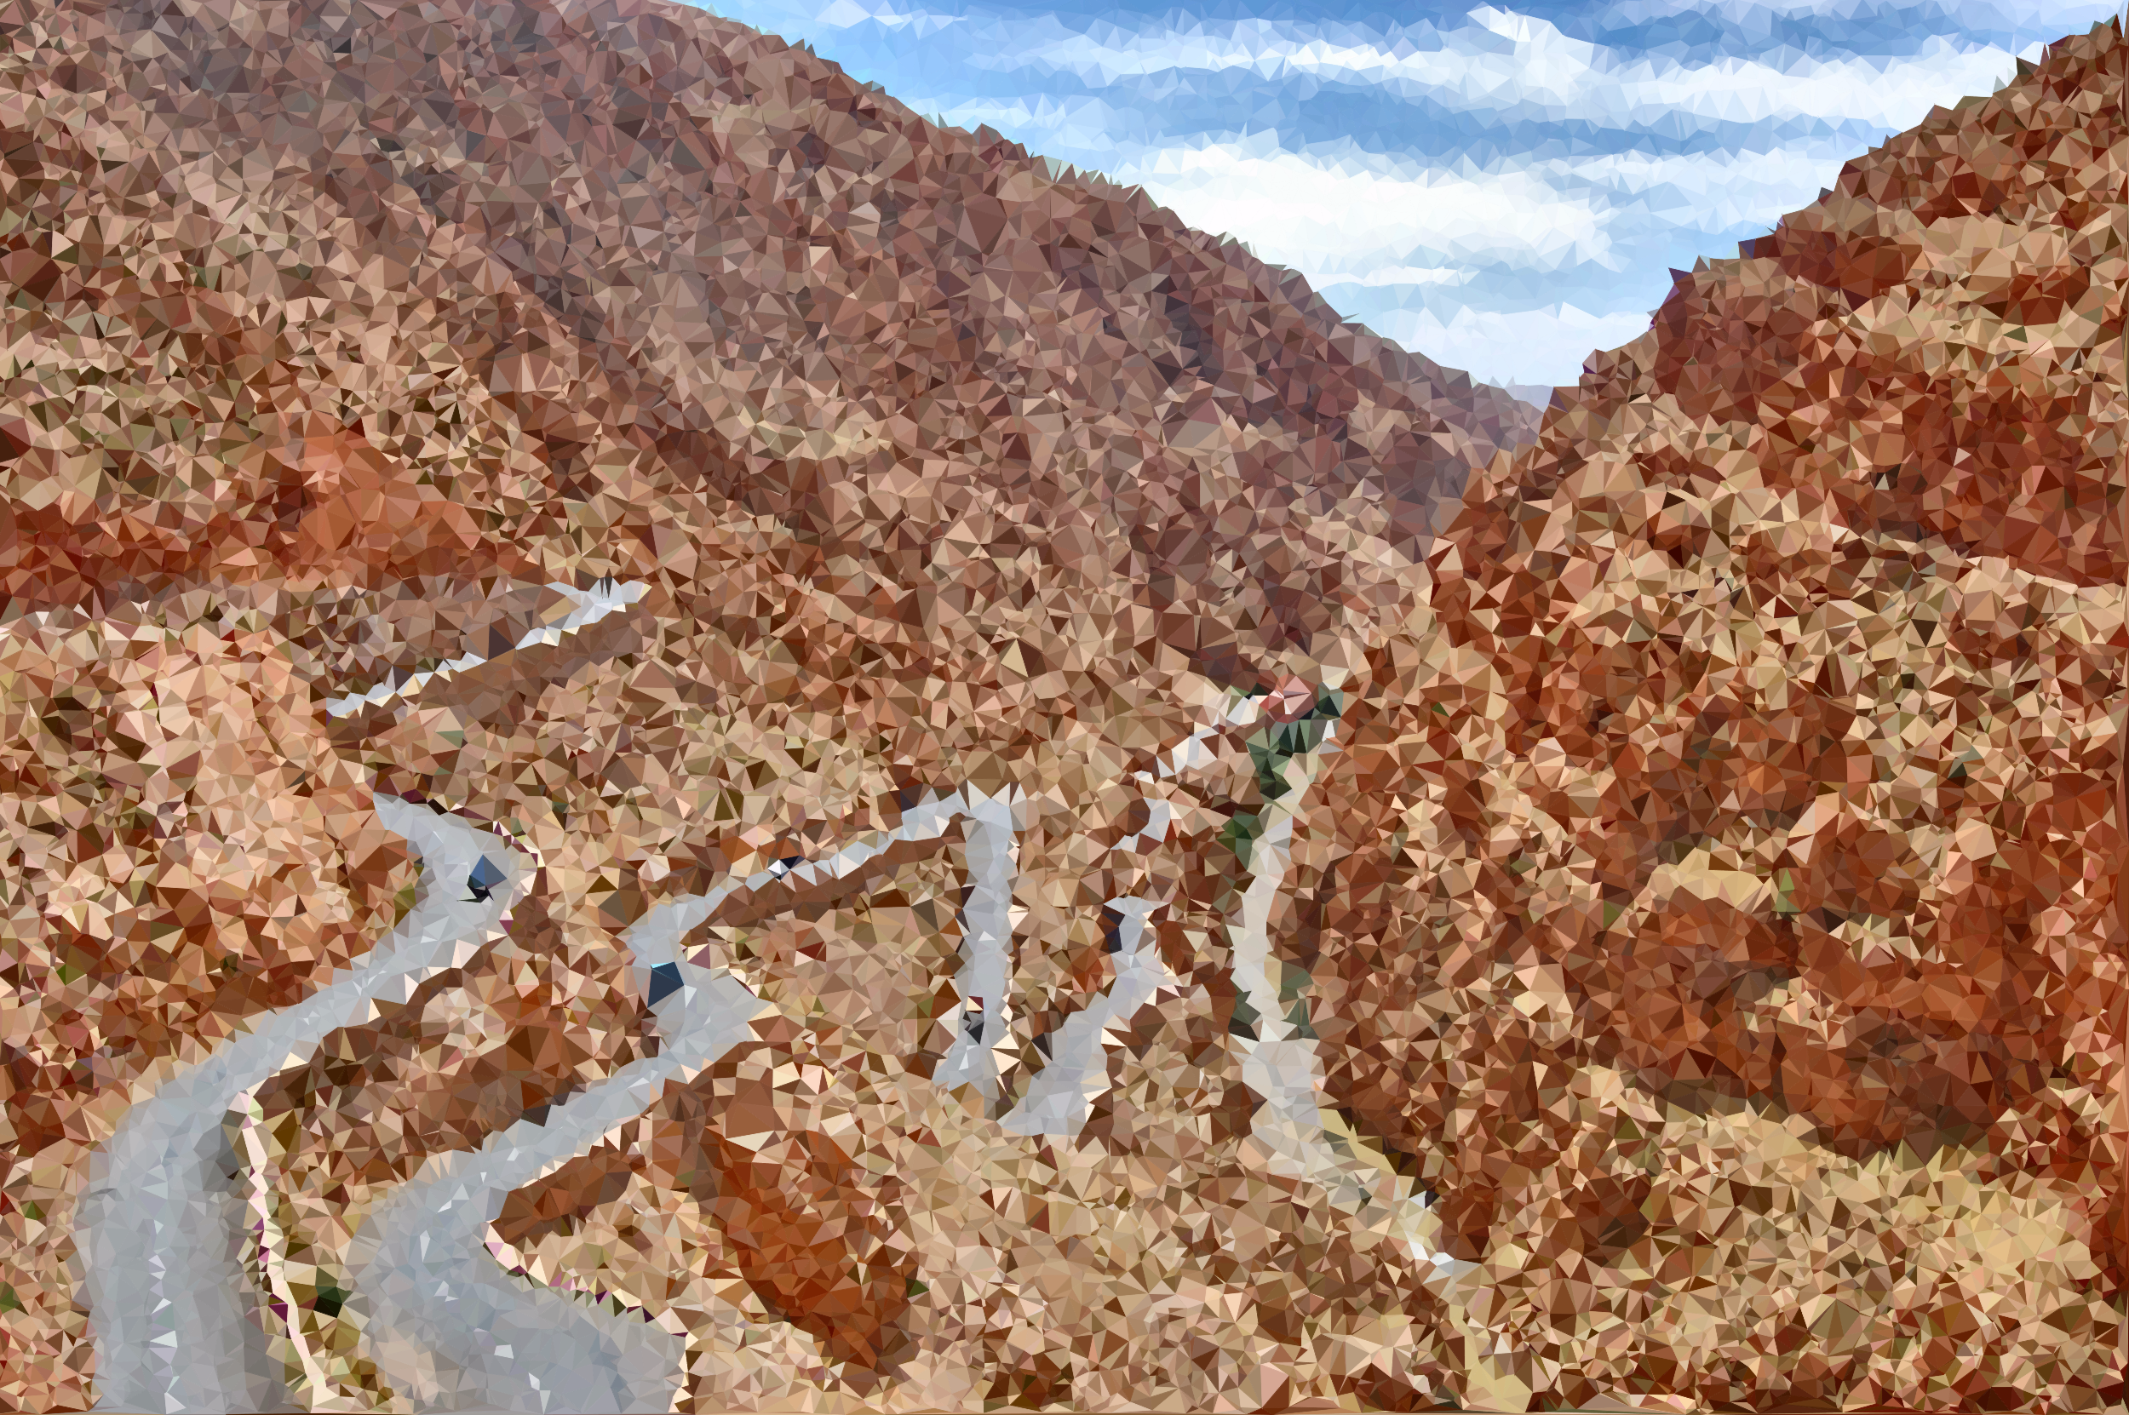
Parallel Journeys
Regulation and approval ?
Technical Implementation
Clip art credits: All licensed as CC0 1.0 Universal, from openclipart.org
https://openclipart.org/download/252227/Medium-Poly-Lombard-Street-Two-Point-Oh-Variation-2.svg by GDJ
https://openclipart.org/download/344496/image-1.svg by xavier7

Slide 7
Technical Journey:
Decided a model – research group tenancies
Already have a private cloud!
Understand connector library
Test MyAccessID connection and authentication
Make connection available in private cloud system
Map to user / resource permissions in tenancy
Security
It has many servers and storage as its resources
Can create tenancies
Has security walling off tenancies and secure access
KeyCloak

Slide 8
Regulation and Admin Journey:
We are first customer
Filling in the service registration form with them
Decided on a model – research group tenancies
Working with Jisc
Reviewing policies and regulations – many sources
Model user info web page
Developing classification of areas of regulation
Engage with internal regulators
MyAccessID per se
Their recommended policies
Service host uni’s own IT Regulations
User’s uni’s own IT Regulations
Tenant’s extra rules for their tenants
Employment law
GDPR
Data providers’ rules
IT Security
Human Resources
Legal
Regulation – mostly by reference
How to authenticate and log in
Site logo for MyAccessID to use!
May reveal who is interested in what
Help identify conflicts of regulations

Slide 9
Clipart Credits
All licensed as CC0 1.0 Universal, from openclipart.org:
https://openclipart.org/detail/16333/isometric-cloud-base - Ericlemerdy
https://openclipart.org/detail/170096/green-house - DominiqueChappard
https://openclipart.org/detail/174369/wall-2 - Jarda
https://openclipart.org/detail/308730/female-scientist-doing-research - GDJ
https://openclipart.org/detail/270563/african-scientist - J4p4n
https://openclipart.org/detail/231773/cartoon-scientist-guy - Dog99x
https://openclipart.org/detail/216555/scientist-with-purple-hair - Barnheartowl
https://openclipart.org/detail/334891/male-teacher-7 - Oksmith
https://openclipart.org/detail/282240/dome - Firkin
https://openclipart.org/detail/231626/under-construction - Hochmohr
https://openclipart.org/download/252227/Medium-Poly-Lombard-Street-Two-Point-Oh-Variation-2.svg - GDJ
https://openclipart.org/download/344496/image-1.svg 8 xavier7

Slide 10
The project playlist
… since the journey metaphor has been stretched already,:
https://open.spotify.com/playlist/35jgaogjVS79obdHIhwIVR?si=4605cfcdbb8d4ce4
(Tracks suggested by Copilot!)

